Slide 1
DAYANANDA SAGAR ACADEMY OF TECHNOLOGY & MANAGEMENT
Udayapura, Kanakapura Road, Bangalore- 560082
Affiliated to Visvesvaraya Technological University, Belagavi and Approved by AICTE, New Delhi
CSE, ISE,EEE,ME,CE Branches Accredited by NBA,NAAC accredited by A+, New Delhi
Department of Artificial Intelligence and Machine learning
Visual Verse: Text-to-Image Generation using Stable Diffusion
Text-to-image generation is a rapidly advancing field that holds immense potential for creative expression and practical applications. Stable Diffusion, a state-of-the-art AI model, is at the forefront of this technology, enabling users to generate and manipulate images using natural language prompts.
By-
Shreyas H S
BM Somashekar
Raghavendra Prasad G Shetti
Muttushery Johnson Brian

Slide 2
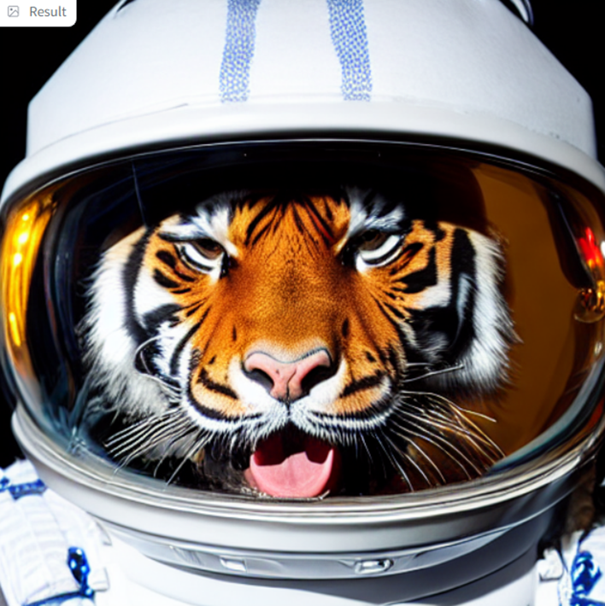

Overview of Text-to-Image Generation and Stable Diffusion
Significance
Stable Diffusion
Text-to-image generation bridges the gap between language and visual expression, unlocking new possibilities for content creation, visualization, and user interaction.
A powerful, open-source AI model that can generate high-quality, photorealistic images from text prompts, pushing the boundaries of what's possible with generative AI.

Slide 3
Applications and Use Cases
Creative Expression
Content Generation
Visualization
Unleash your creativity by generating unique, personalized artwork, illustrations, and visual concepts based on text descriptions.
Streamline content creation processes by generating images for advertisements, social media, e-commerce, and more using text prompts.
Bring abstract ideas and concepts to life by generating visual representations from textual descriptions, aiding in design, planning, and communication.

Slide 4

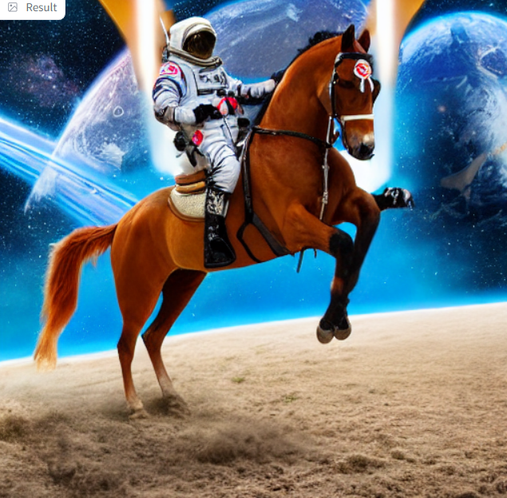
The Architecture of Stable Diffusion
1
Diffusion Models
Stable Diffusion is based on diffusion models, a type of generative AI that learns to generate images by gradually adding noise to the input and then removing it.
2
Stable Diffusion v1-5
The Stable Diffusion model has undergone several iterative improvements, with each version offering enhanced capabilities, efficiency, and safety controls.
3
CLIP Text Encoder
The CLIP text encoder plays a crucial role in Stable Diffusion, translating text prompts into a latent representation that guides the image generation process.

Slide 5
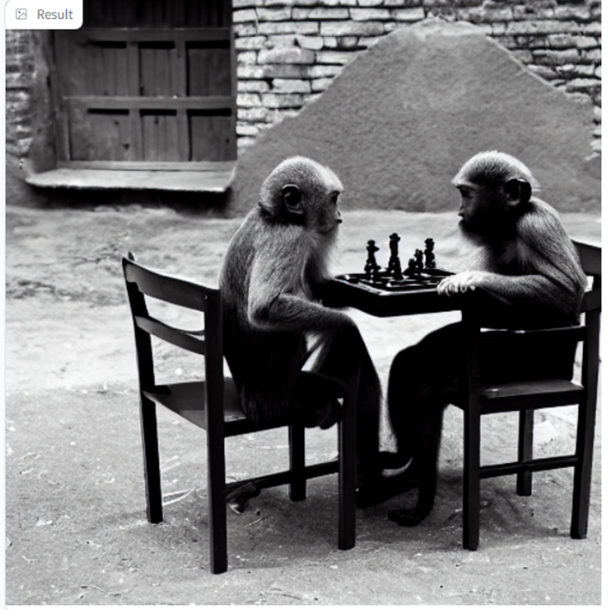


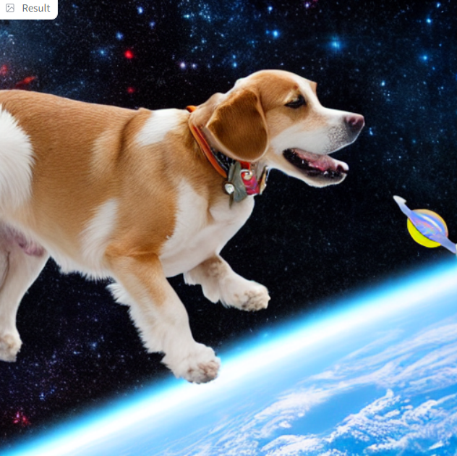


Technical Requirements and Libraries
Python
Diffusers
The primary programming language used for text-to-image generation with Stable Diffusion.
A high-level library for working with diffusion models, including Stable Diffusion.
Transformers
Gradio
A library for working with pre-trained natural language processing models, such as the CLIP text encoder.
A Python library for building user interfaces for machine learning models, allowing for interactive text-to-image generation.

Slide 6
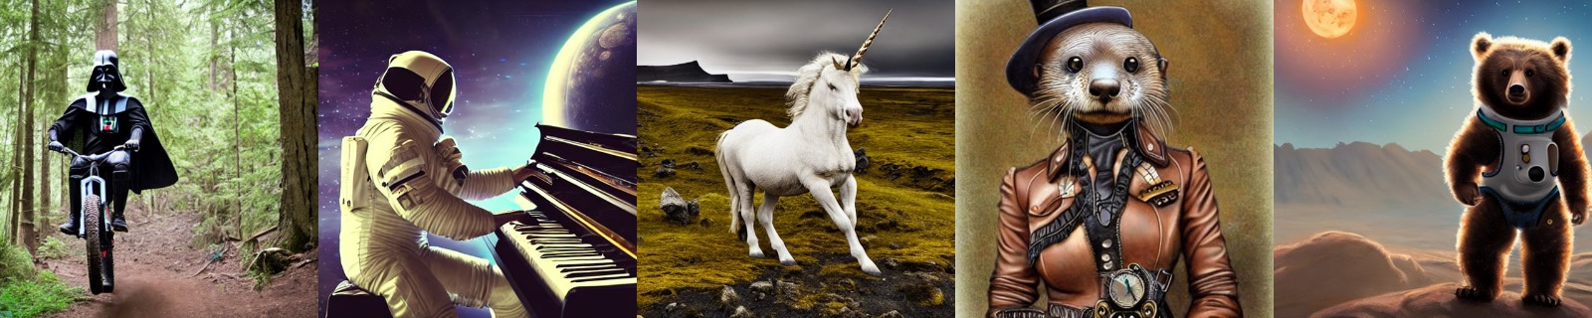
Demo and Results
The diverse range of images showcases the versatility of Stable Diffusion, from surreal landscapes to futuristic cityscapes and digital portraits. Fine-tuning the text prompts and adjusting model parameters can further refine the generated results to capture the desired aesthetics and mood.

Slide 7
Challenges and Solutions
Image Quality: Ensuring consistent high-quality output, especially for complex or detailed prompts, can be challenging. Techniques like model fine-tuning and prompt optimization help address this.
Prompt Sensitivity: The text prompts used to generate images can heavily influence the output, requiring careful crafting and experimentation to achieve the desired results.
Computational Constraints: The resource-intensive nature of text-to-image generation can pose challenges, particularly on less powerful hardware. Strategies like caching, model optimization, and distributed processing help mitigate this.
Ethical Considerations: Responsible development and deployment of text-to-image AI models must address potential biases, privacy concerns, and misuse, requiring thoughtful design choices and safety controls.

Slide 8

Thank You
We appreciate your time and attention. We hope this presentation has provided valuable insights into the power of text-to-image generation using Stable Diffusion.

